Slide 1

NATIONALISM IN INDIA
NATIONALISM
IN
INDIA

Slide 2
GANDHIJI DECIDED TO LAUNCH THE NON- COOPERATION MOVEMENTBECAUSE :
First World War added to the misery of the Indian people. Heavy taxes, high prices, famines and epidemics made people’s life miserable.
Rowlatt Act invited large scale protests throughout the country.
Jallianwala Bagh Massacre and the injustice done to Punjab made Indians angry.
Muslims became unhappy due to the ill treatment of Turkey. They started Khilafat Movement.
The Congress session at Nagpur (1920) adopted Gandhiji’s the idea of Non-co operation.

Slide 3
NON-COOPERATION MOVEMENT
Non co operation was launched under Gandhiji’s leadership in 1920.
It aimed at protesting against the injustices done to Punjab and Turkey and to attain Swaraj.
Educated middle class led the movement in towns and cities. Educational institutions, Law courts and foreign goods were boycotted.
Peasants organized movements against Talukdars and Landlords in villages under the leadership of Baba Ramchandra.
Tribal people started an armed struggle in the Gudem hills of Andhra Pradesh under the leadership of Alluri Sitaram Raju.
Workers in the plantations of Assam started a struggle to get the right to free movement.
Chauri-Chaura incident forced Gandhiji to call off the Movement.

Slide 4
DIFFERING STRANDS WITHIN THE
NON COOPERATION MOVEMENT
MOVEMENT IN TOWNS AND CITIES:
Educated middle class led the movement in towns and cities.
Educational institutions, law courts and the council elections were boycotted.
Foreign clothes and other goods were burnt in bonfires. People began to use Khadi clothes.
Government Servants resigned their jobs. Liquor shops were picketed.

Slide 5
NON CO OPERATION MOVEMENT SLOWED DOWN IN TOWNS AND CITIES BECAUSE:
Khadi clothes were very costly. The poor were not able to buy them.
Indians boycotted British institutions like law courts and educational institutions. But alternative institutions did not come up. So people had to stop boycott.

Slide 6
MOVEMENT IN THE COUNTRYSIDE
(VILLAGES)
PEASANTS’ MOVEMENT.
In Awadh, a peasant’s movement was organized by Baba Ramchandra.
It was against landlords and talukdars. Reduction of rent and the abolition of begar were their main demands.
They formed the Oudh Kisan Sabha.

Slide 7
BABA RAMCHANDRA
He led a peasant’s movement in Awadh against Talukdars and Landlords.
He demanded reduction of rent, abolition of Begar and the boycott of landlords.
In October 1920, he formed Oudh Kisan Sabha with the help of Nehru.

Slide 8
TRIBAL MOVEMENT
In the Gudem Hills of Andhra Pradesh, tribals started a movement under the leadership of Alluri Sitaram Raju.
Tribals wanted to get back their traditional rights over forests.
The methods followed by the tribals and peasants were against the Gandhian method of non violence. They followed violent methods of struggle.

Slide 9
ALLURI SITARAM RAJU
He led a movement of the tribal people in the Gudem hills of Andhra Pradesh.
Many people considered him as an incarnation of God. They believed that he had many special powers.
He supported Gandhiji and asked his followers to wear khadi and stop drinking. But, he organized an armed struggle against the British.

Slide 10
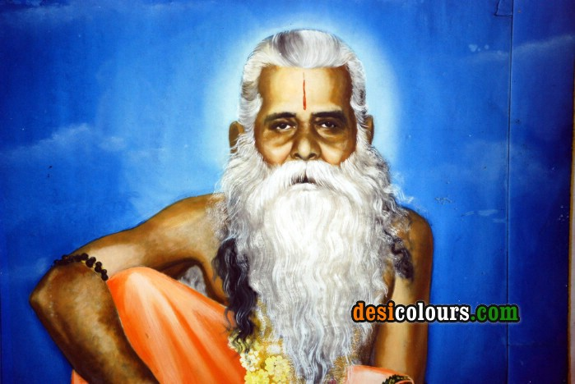
ALLURI SITARAM RAJU

Slide 11
MOVEMENT IN THE PLANTATIONS
Workers in the plantations of Assam demanded the right to move freely in and out of the estates.
They opposed the Inland Emigration Act of 1859 which took away the right to free movement.
When they heard about the Non-co operation movement, they moved to their villages. They thought that the Gandhi Raj was coming and everyone would be given land in their villages.
However, they were caught and brought back

Slide 12
WITHDRAWAL OF THE NON COOPERATION MOVEMENT
Gandhiji withdrew the Non Co operation Movement because:
The movement became violent in some places. In february 1922, in Chauri chaura (Uttar Pradesh) people turned violent and set fire to a police station. Twenty two police men were killed in this incident. Gandhiji was against violence.
The movement slowed down in urban areas.
He thought that it was necessary to train the people in non violent satyagraha.

Slide 13
SIGNIFICANCE OF THE
NON- COOPERATION MOVEMENT
Non Co operation movement was a large scale mass movement. It attracted common people from all social groups.
Non Co operation Movement and Khilafat Movement went together. So, they promoted Hindu-Muslim unity.
Peasants’ and tribals’ movements became a part of the Indian National Movement.
It was a non violent movement. So, it popularised the Gandhian idea of Non violent satyagraha.

